Slide 1


Finding the Right City for You
UCSD DSC
Parker Addison
Will Bates
Allston Fojas
Erik Mumm
Cole Richmond

Slide 2
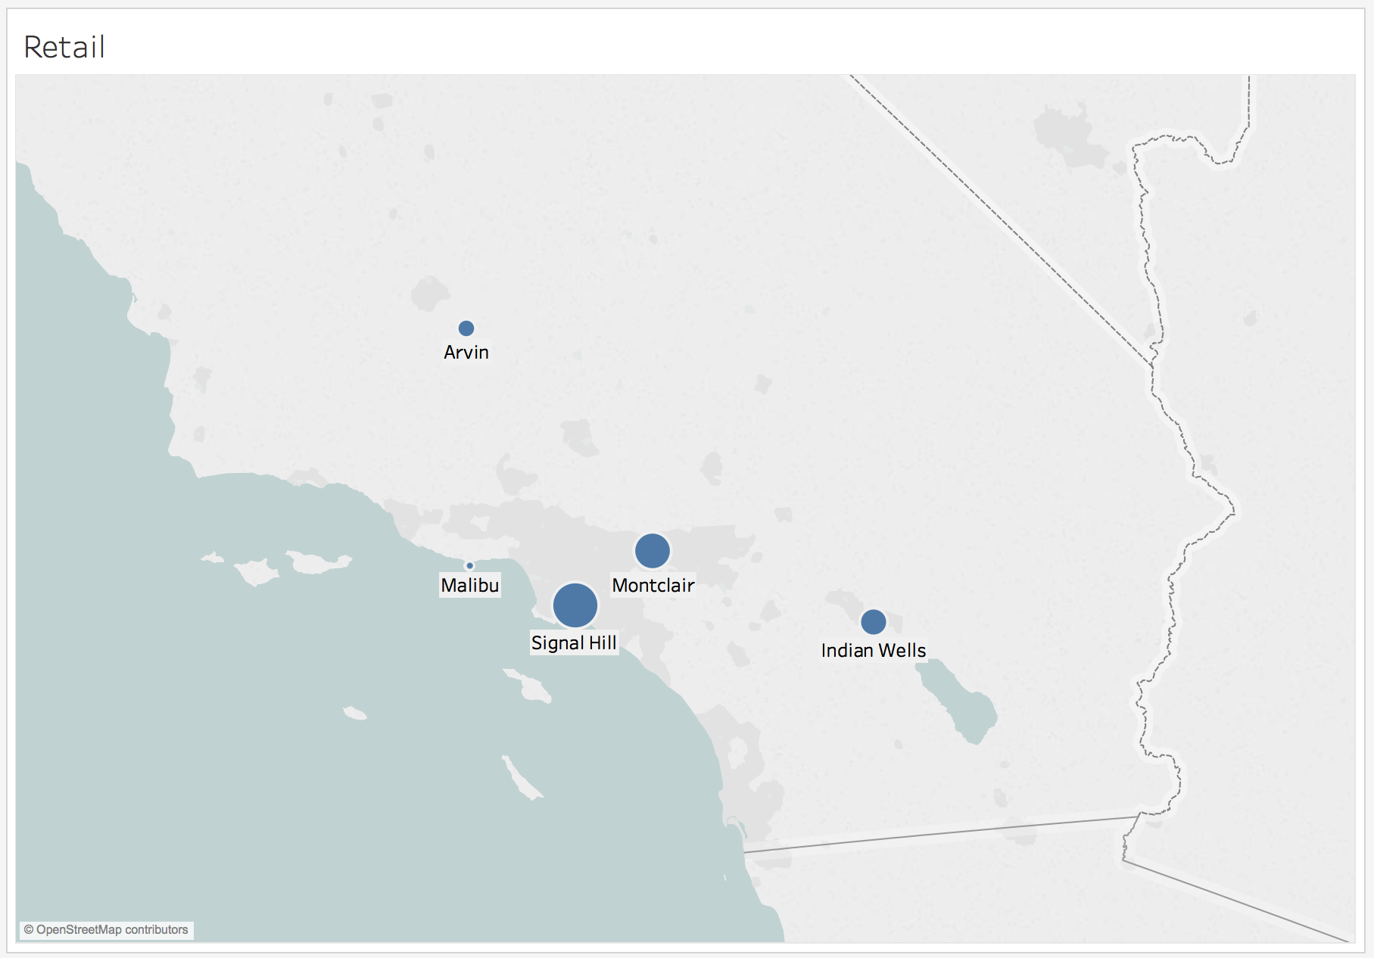
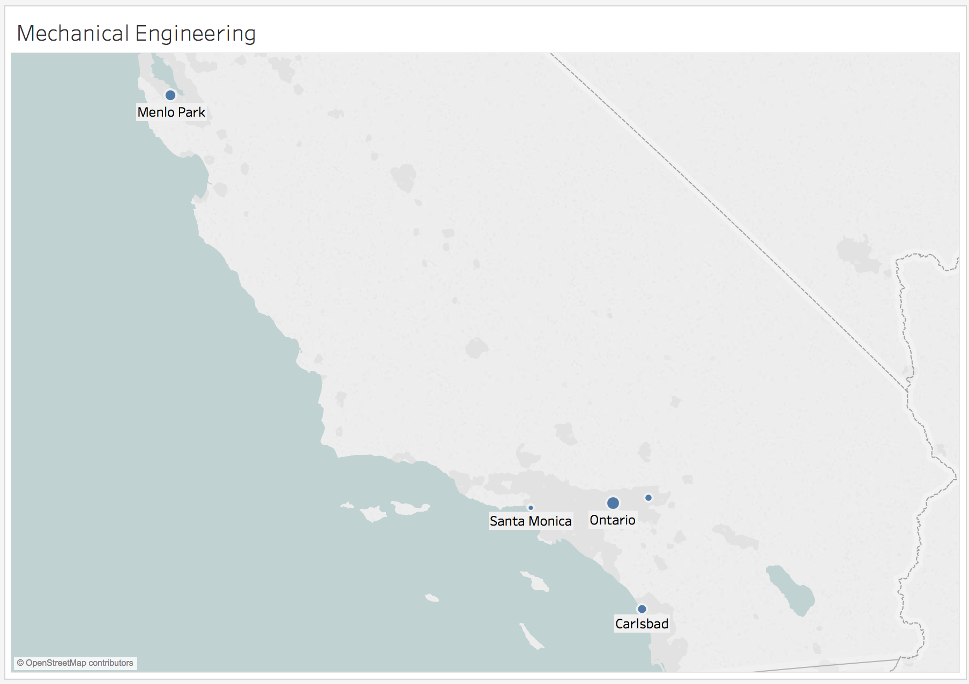
Best Cities For:
Target Audience: Users who encounter limited options within 100 mile radius.
Problem: Overwhelming options when expanding to State or Country.
Goal: Simplify the taxing process of preparing to move for work by providing recommended cities based on cost of living in that city, competition, salary, and availability of jobs in user’s category.

Slide 3
Procedure and Algorithm
You
Feature selection and extraction from Indeed's data set
Population and income data from external sources
Ranked all cities on: Competition, Availability, Quality
Compiled ranks for all cities
Produced algorithm to output top 3 and bottom 3 cities to move to for the new job
Low Competition
High Salaries
Low Cost of Living
High Job Availability
Denver, CO
Houston, TX
Irvine, CA
Sources: US Census, Bureau of Economic Analysis, CA.gov

